Slide 1

Automata Theory Lecture: 12 FA with output
Farhad Muhammad Riaz

Slide 2
Moore Machine
A Moore machine consists of the following
A finite set of states q0, q1, q2, … where q0 is the initial state.
An alphabet of letters ∑= {a,b,c,…} from which the input strings are formed.
An alphabet L={x,y,z,…} of output characters from which output strings are generated.
A transition table that shows for each state and each input letter what state is entered the next.
An output table that shows what character is printed by each state as it is entered.

Slide 3
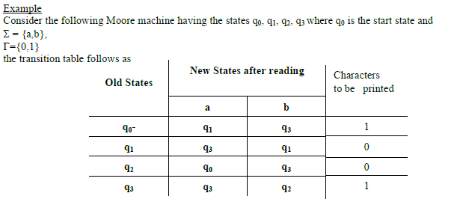
Moore Machine

Slide 4
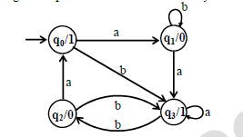
Moore Machine

Slide 5
Moore Machine
Running the string abbabbba over the above machine, the corresponding output string will be 100010101,

Slide 6
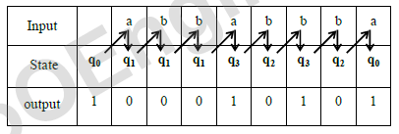
Moore Machine

Slide 7
Moore Machine
It may be noted that the length of output string is l more than that of input string as the initial state prints out the extra character 1, before the input string is read.

Slide 8
Mealy Machine
A Mealy machine consists of the following
A finite set of states q0, q1, q2, … where q0 is the initial state.
An alphabet of letters ∑ = {a,b,c,…} from which the input strings are formed.
An alphabet L={x,y,z,…} of output characters from which output strings are generated.
A pictorial representation with states and directed edges labeled by an input letter along with an output character. The directed edges also show how to go from one state to another corresponding to every possible
input letter. (It is not possible to give transition table in this case.)

Slide 9
Mealy Machine
Example
Consider the Mealy machine shown aside, having the states q0, q1, q2, q3 , where q0 is the start state and
∑= {a,b},
L={0,1}

Slide 10
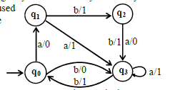
Mealy Machine

Slide 11
Mealy Machine
Running the string abbabbba over the above machine, the corresponding output string will be 11011010

Slide 12
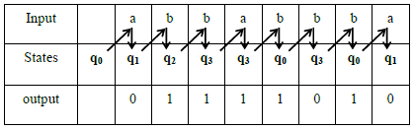
Mealy Machine

Slide 13
Mealy Machine
It may be noted that in Mealy machine, the length of output string is equal to that of input string

Slide 14
Equivalent machines
Two machines are said to be equivalent if they print the same output string when the same input string is run on them.
Two Moore machines may be equivalent. Similarly two Mealy machines may also be equivalent,
but a Moore machine can’t be equivalent to any Mealy machine.
However, ignoring the extra character printed by the Moore machine, there exists a Mealy machine which is equivalent to the Moore machine

Slide 15
Theorem
Statement
For every Moore machine there is a Mealy machine that is equivalent to it (ignoring the extra character printed by the Moore machine).

Slide 16
Proof
Let M be a Moore machine, then shifting the output characters corresponding to each state to the labels of corresponding incoming transitions, machine thus obtained will be a Mealy machine equivalent to M.

Slide 17
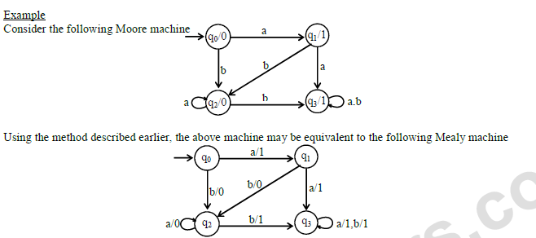
Proof

Slide 18
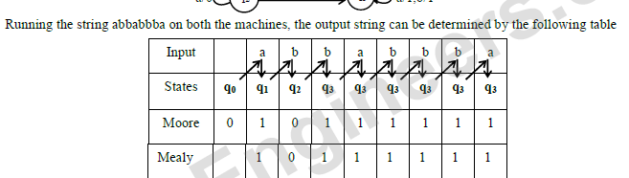

Slide 19
Theorem
Statement
For every Mealy machine there is a Moore machine that is equivalent to it (ignoring the extra character printed the Moore machine).

Slide 20
Proof
Let M be a Mealy machine. At each state there are two possibilities for incoming transitions The incoming transitions have the same output character. The incoming transitions have different output characters.
If all the transitions have same output characters, then shift that character to the corresponding state.
If all the transitions have different output characters, then the state will be converted to as many states as the
number of different output characters for these transitions, which shows that if this happens at state qi then qi will be converted to qi 1 and qi 2 i.e. if at qi there are the transitions with two output characters then qi 1 for one character and qi 2 for other character.
Shift the output characters of the transitions to the corresponding new states qi
1 and qi 2.
Moreover, these new states qi 1 and qi
2 should behave like qi as well. Continuing the process, the machine thus obtained, will be a
Moore machine equivalent to Mealy machine M.

Slide 21
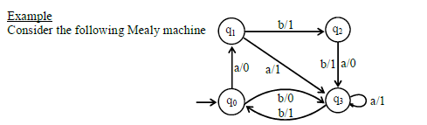

Slide 22
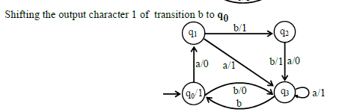

Slide 23
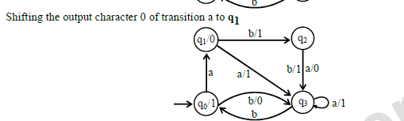

Slide 24
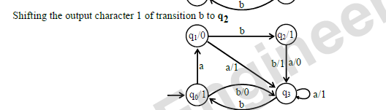

Slide 25
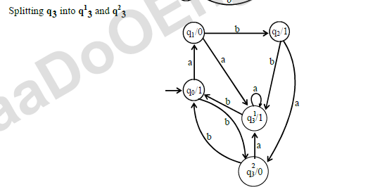

Slide 26
